Slide 1
Mini Project

Slide 2
Agenda
Business Case
Data Preparation
Data Analysis
Modeling and Feature Importance
Conclusion and Recommendations

Slide 3


Apple Inc. (AAPL)

Slide 4


Apple Inc. (AAPL)

Slide 5

Apple Inc. (AAPL)

Slide 6
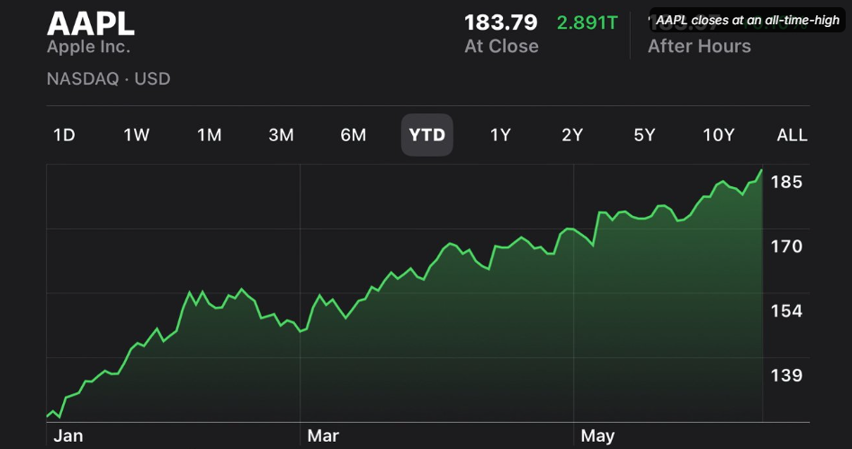
Apple Inc. Stock Price Analysis and Prediction
Problem & strategies

Slide 7
Objective:
Objective: Predict the future closing prices of Apple Inc. (AAPL) based on historical stock data using a linear regression model.

Slide 8
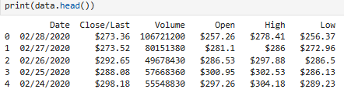
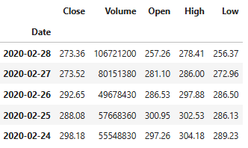
Data Preparation:
Dataset Overview:
Source: Historical stock prices of Apple Inc. (AAPL).
Key features: Date, Open, High, Low, Close, Volume.
Data Cleaning Steps:
Converted Date to datetime format.
Removed dollar signs and converted price columns to float.
Renamed columns for consistency.
Set Date as the index.
Ensured no missing values.

Slide 9
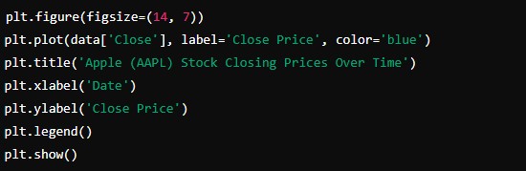
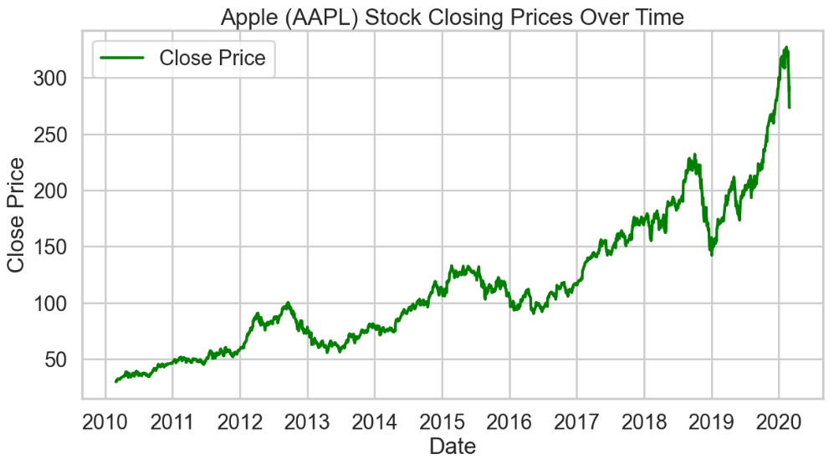
Data Analysis
Key Findings:
Closing Price Trend: Displayed a general upward trend with periodic fluctuations.
Closing Price Over Time:

Slide 10
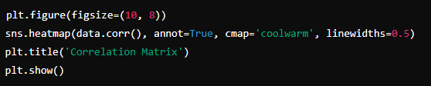
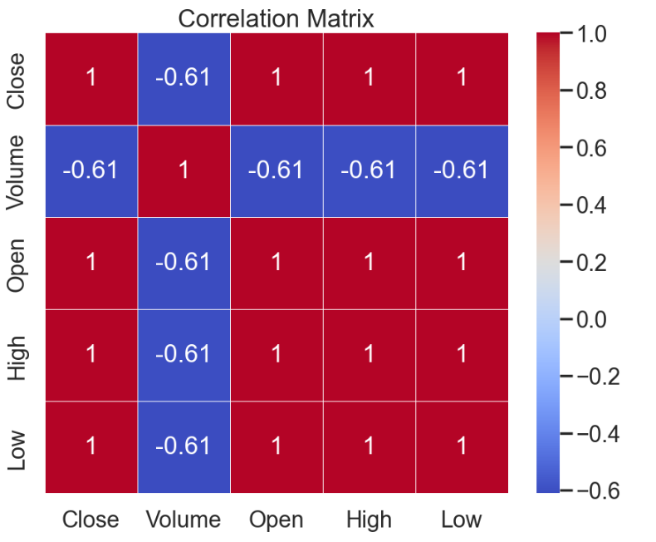
Data Analysis
Correlation Matrix:
Correlation Matrix: Identified significant correlations among features, especially between closing prices and lagged values.

Slide 11
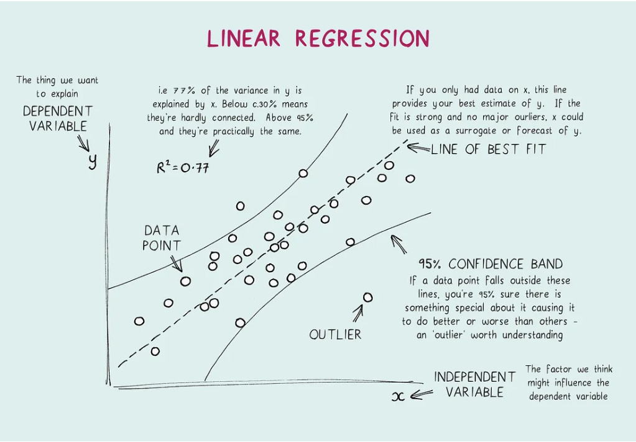
Modeling
Model:
Linear Regression
Features:
Lag Features
Moving Averages
Exponential Moving Averages
Relative Strength Index (RSI)
Model Evaluation Metrics:
Mean Squared Error (MSE): Measures the average squared difference between actual and predicted values.
R-squared (R²) Score: Indicates the proportion of the variance in the dependent variable that is predictable from the independent variables.

Slide 12
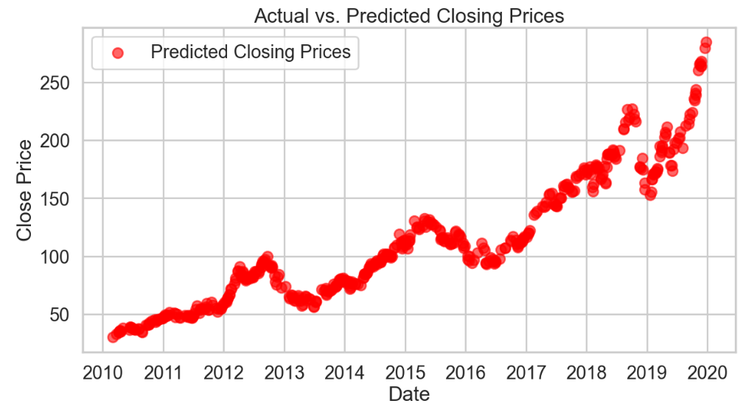
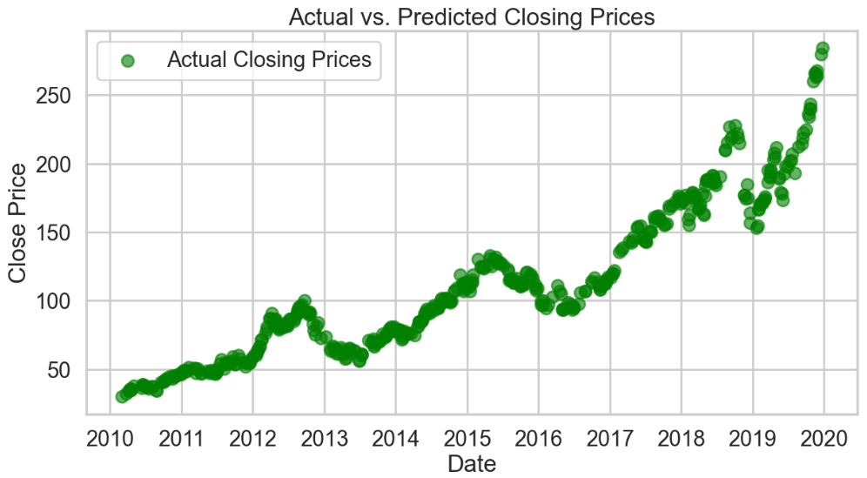
Model Evaluation Feature Importance: Coefficients from the linear regression model indicate the importance of each feature.

Slide 13
Conclusion
The linear regression model effectively predicts Apple's stock closing prices using historical data and engineered features.
Key features influencing the model include lagged closing prices, moving averages, and RSI.
Business Impact:
Provides a tool for investors to predict future stock prices, aiding in investment decisions and risk management.

Slide 14
Recommendations
Additional Features: Incorporate macroeconomic indicators, sentiment analysis, and other financial ratios.
Advanced Models: Explore ARIMA, LSTM, or other machine learning algorithms for improved accuracy.
Hyperparameter Tuning: Optimize model parameters to enhance performance.
Backtesting: Validate the model on out-of-sample data to ensure robustness.

Slide 15
Navigating Q&A sessions

Slide 16
Thank you

